Slide 1
TESTABILITY MEASURES
P.RAJESHM.Tech.,

Slide 2
What is Testability measure?
◻ Metric to measure degree of difficulty to test a circuit
Two important components:
◻ Controllability
 degree of difficulty to control a logic signal to 0 or 1
◻ Observability
 degree of difficulty to observe the logic value of a signal

Slide 3

The notions of controllability and observability of signals in a circuit originated in automatic control theory.
Controllability for a digital circuit is defined as the difficulty of setting a particular logic signal to a 0 or a 1.
Observability for a digital circuit is defined as the difficulty of observing the state of a logic signal. These measures are important for circuit testing, because while there are methods of observing the internal signals of a circuit, they are prohibitively expensive.
Example:
Electron beam testing:-
can actually scan the VLSI chip-under-test and produce a picture of the chip layout. The signals at logic 0 will appear in one color in the image, and those charged to logic 1 appear as another color. However, this testing method is used only for specialized purposes, because of its very high cost.
Therefore, we must instead set internal signals by setting signals at primary inputs (PIs), and we must observe internal signals by arranging to propagate their values to primary outputs (POs.)
The controllability and observability measures are useful because they approximately quantify how hard it is to set and observe internal signals of a circuit.

Slide 4
Testability analysis usually has two significant attributes:
It involves circuit topological analysis, but no test vectors. It is a static type of analysis.
It has linear complexity, because otherwise testability analysis is pointless and one might as well use automatic test-pattern generation (ATPG) or fault simulation.
• Goldstein developed the SCOAP testability measures, and contributed a linear complexity algorithm to compute them. He defined separate zero and 1- controllabilities for each signal as measures of the effort (or difficulty) of setting the line to a logic 0 or 1 value.

Slide 5
Another type of testability measure is probability-based. These overcome some limitations of SCOAP.
Being related to signal probabilities, they are easier to interpret and their values always range between 0 and 1.
The 1-controllability (C1) is the probability of a signal value on line l being set to 1 by a random vector.
The 0-controllability (C0) is the probability of a signal value on line l being set to 0 by a random vector.

Slide 6
SCOAP Controllability and Observability
Goldstein invented an algorithm to determine the difficulty of controlling (called controllability) and observing (called observability) signals in digital circuits.
SCOAP consists of six numerical measures for each signal (l) in the circuit:
1. Combinational 0-controllability, CC0(l)
2. Combinational 1-controllability, CC1(l)
3. Combinational observability, CO(l)
4. Sequential 0-controllability, SC0(l)
5. Sequential 1-controllability, SC1(l)
6. Sequential observability, SO (l)
The controllabilities range between 1 and ∞ and observabilities lie between 0 and ∞ The higher the measures for a line, the more difficult it will be to control or observe.

Slide 7
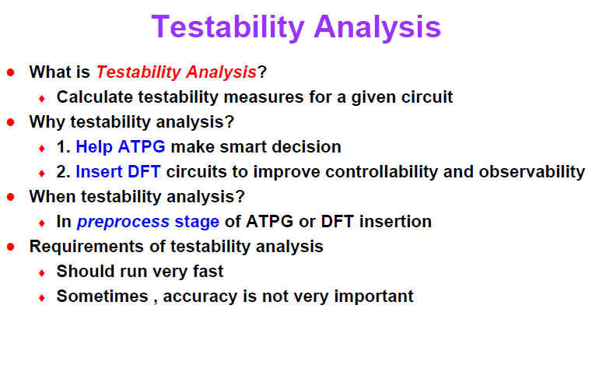

Slide 8
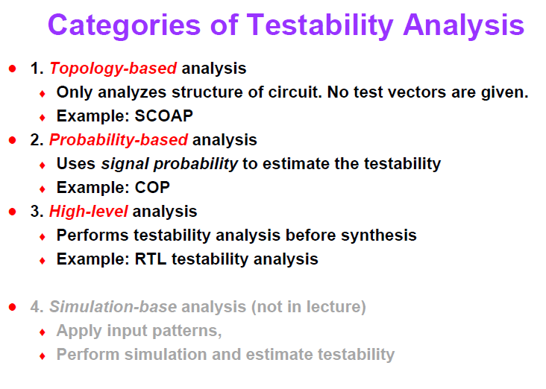

Slide 9
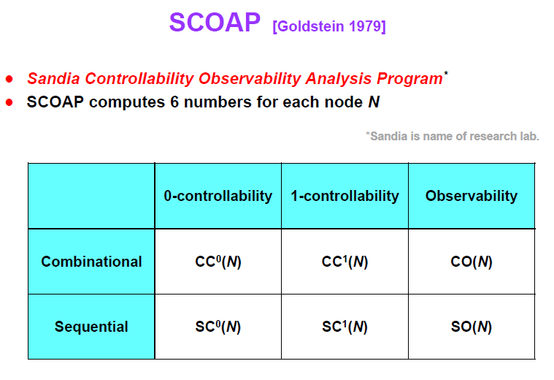

Slide 10
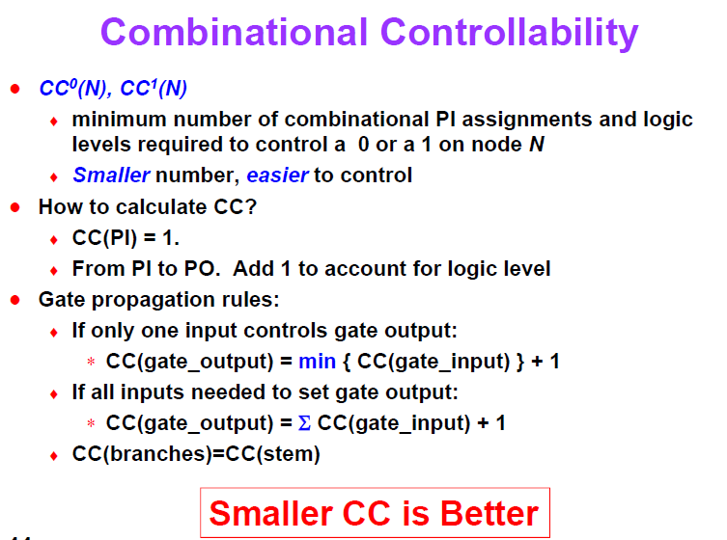

Slide 11
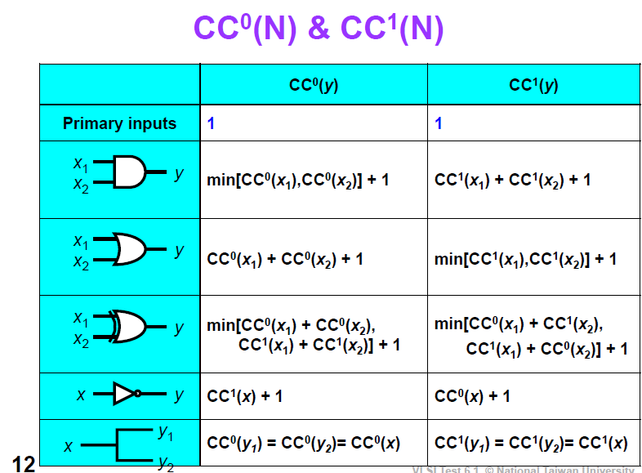
v

Slide 12
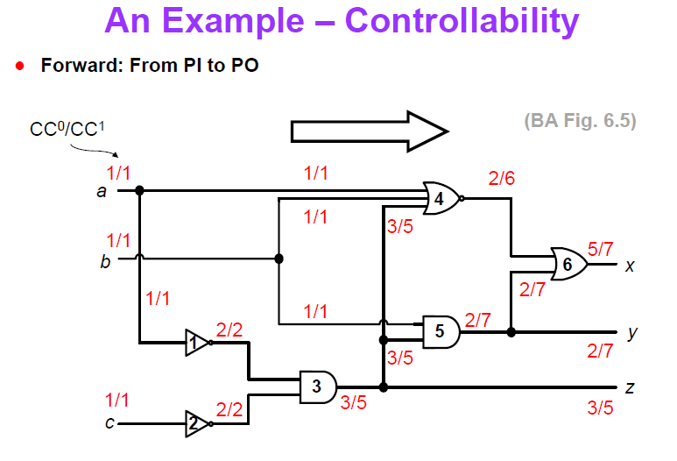
Min(2,2)+1
(2+2+1)

Slide 13
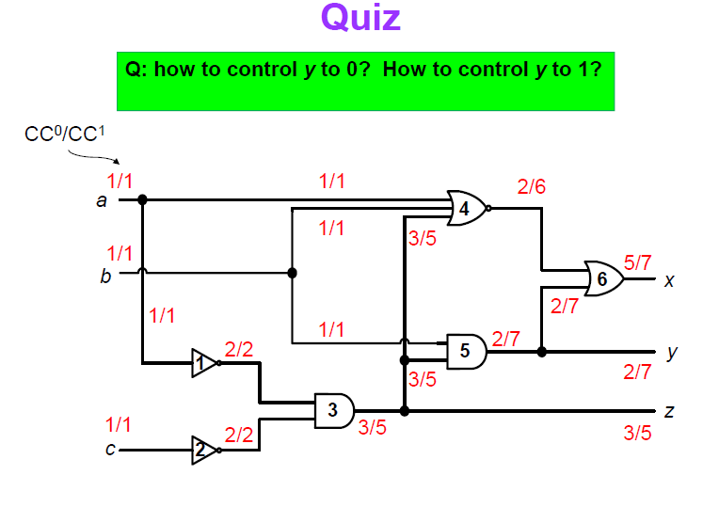
Note : Smaller CC values is easier to control than larger CC values of Output
CC1
cc0

Slide 14
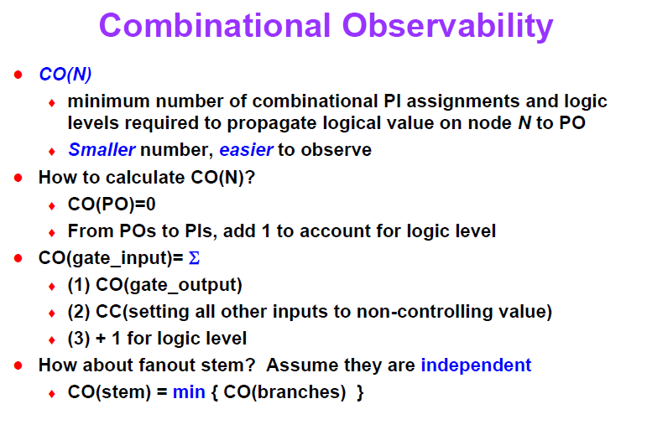

Slide 15
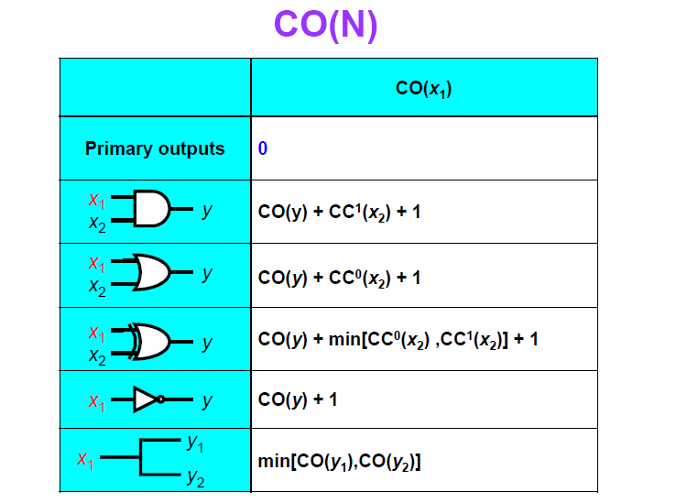

Slide 16
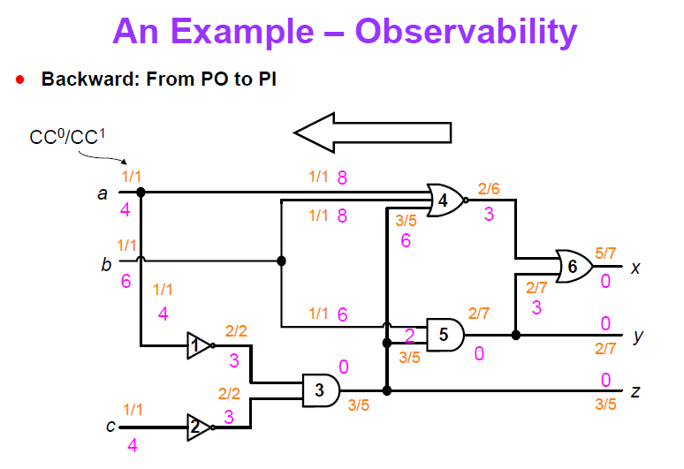
handwritten\unit3\1.pdf
L
R
(0+2+1)
0+Signed input+1

Slide 17
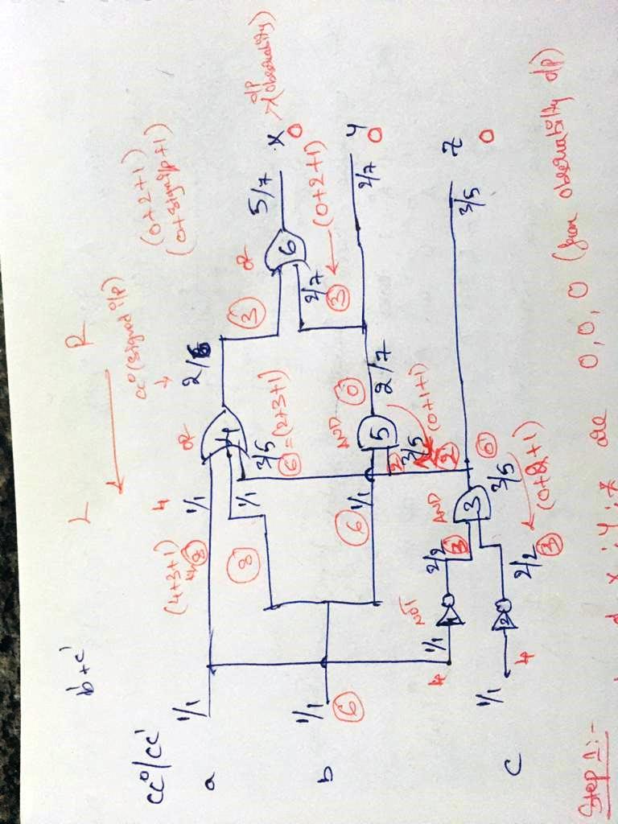

Slide 18
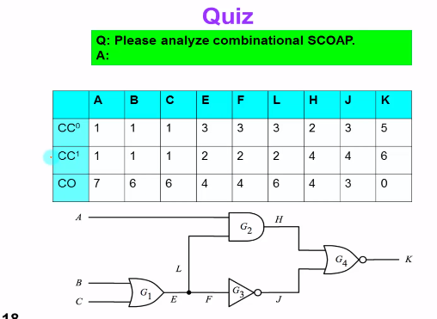

Slide 19
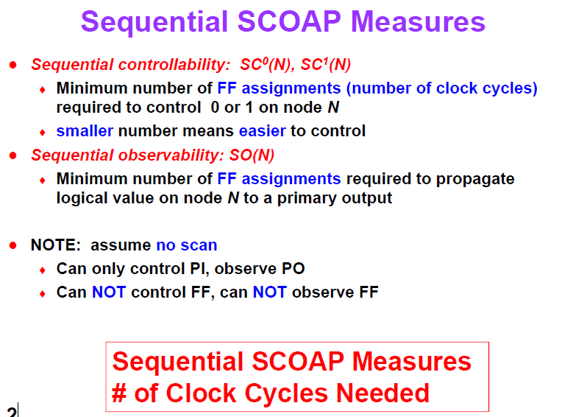

Slide 20
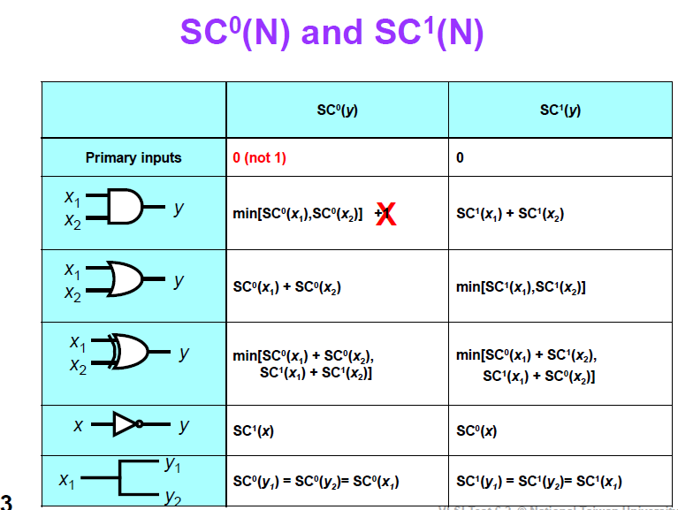

Slide 21
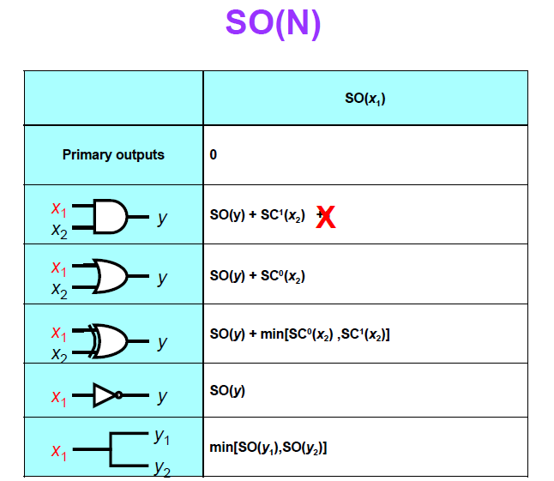

Slide 22
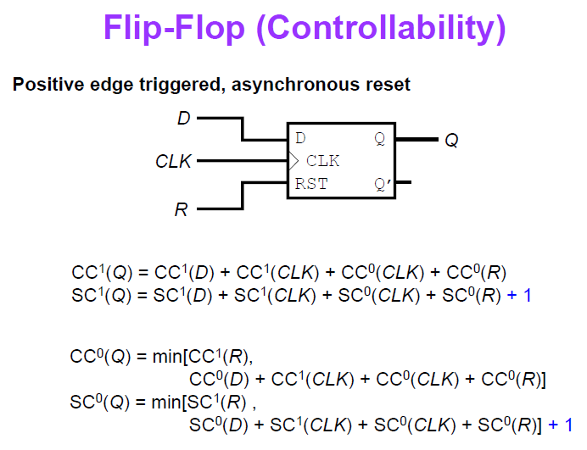

Slide 23
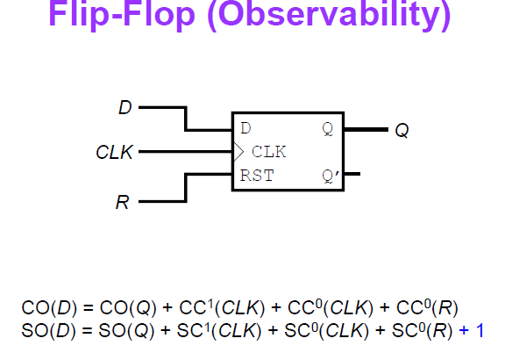

Slide 24
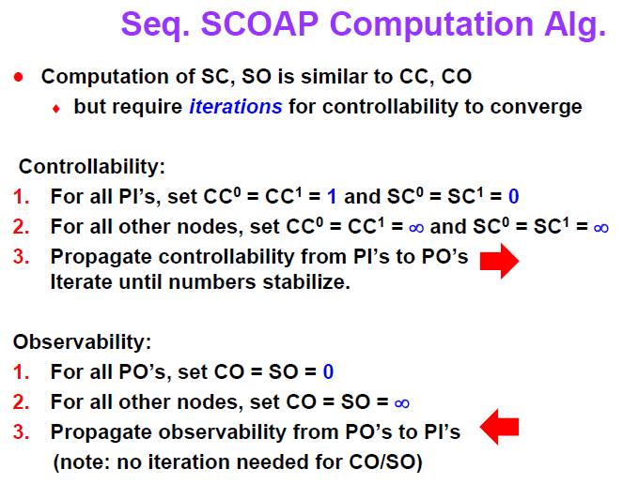

Slide 25
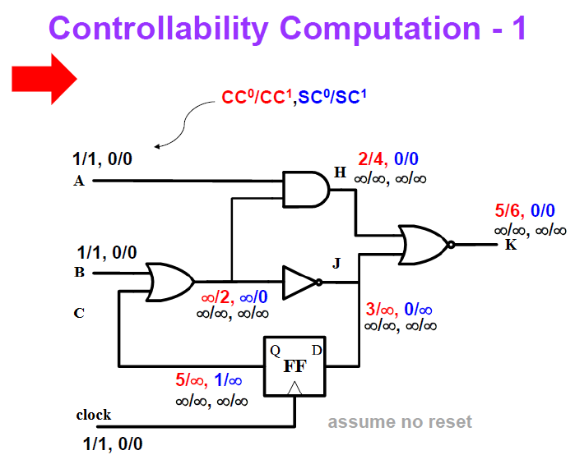

Slide 27
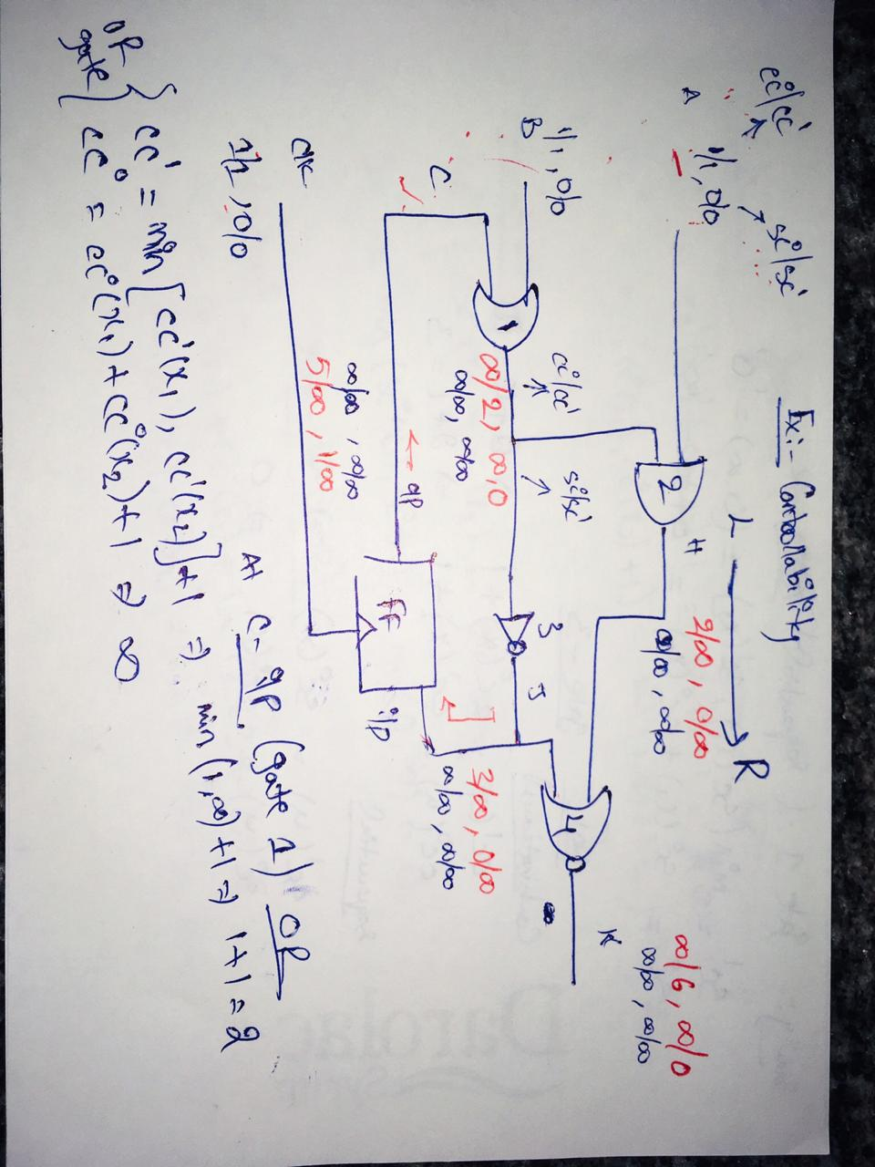

Slide 28
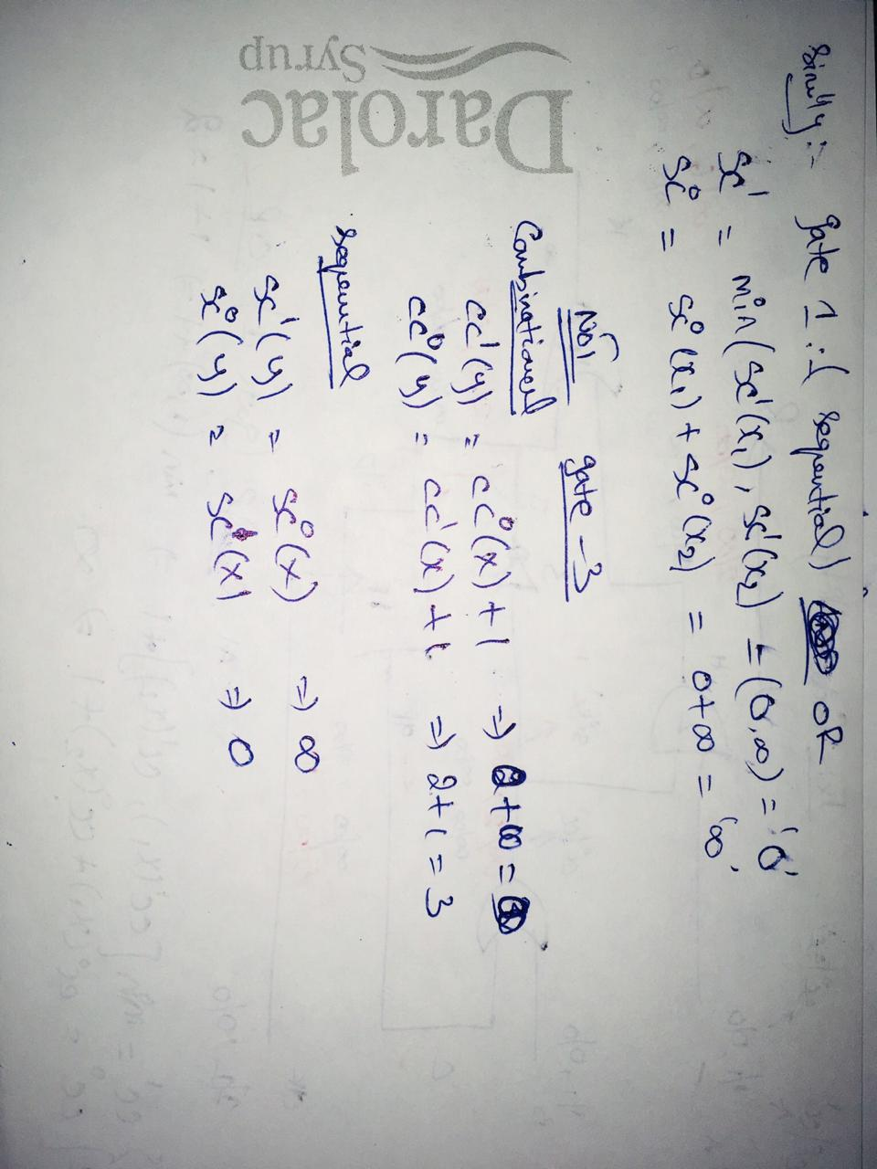

Slide 29
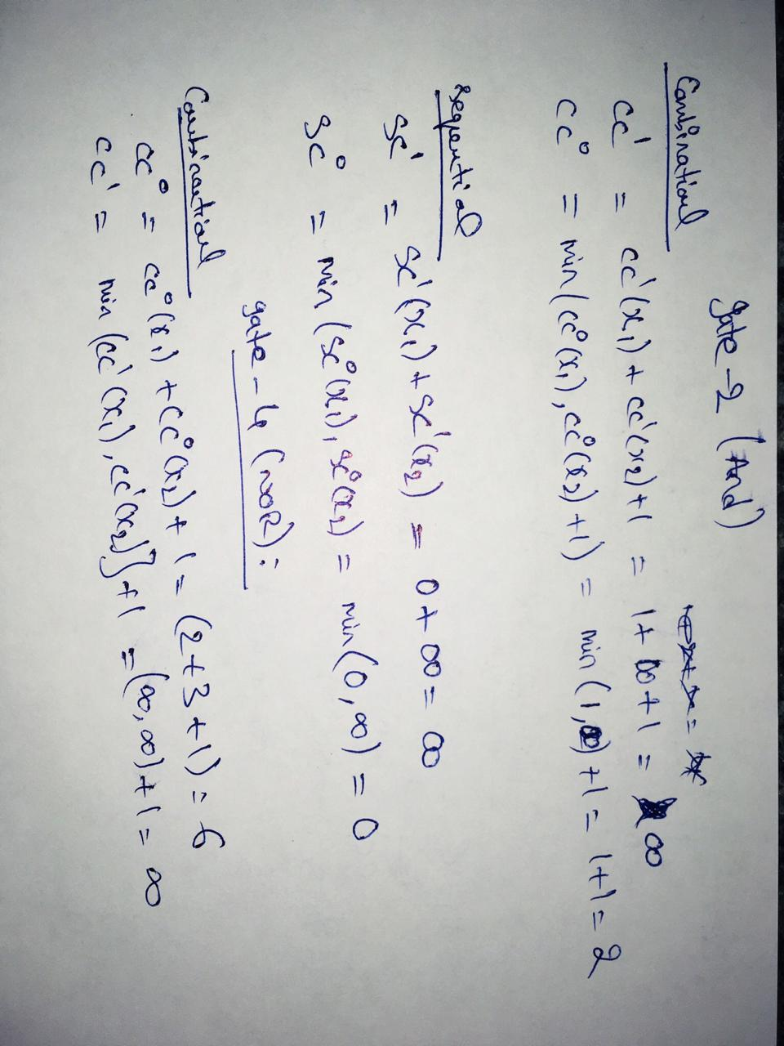

Slide 30
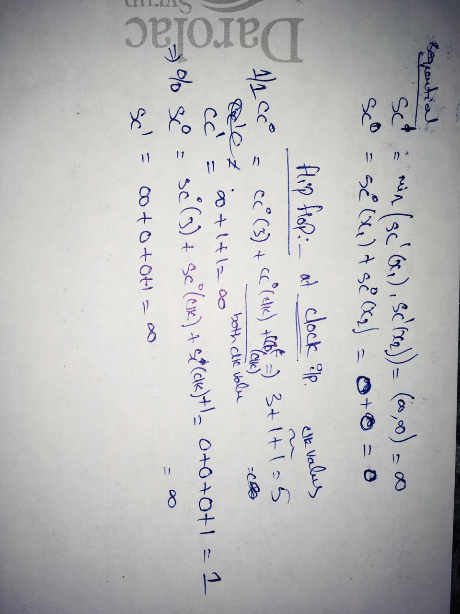

Slide 31
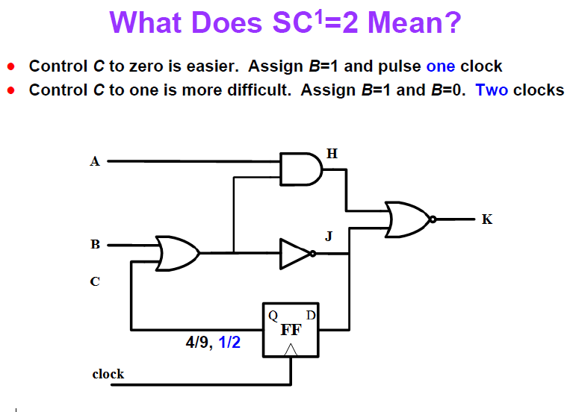

Slide 32
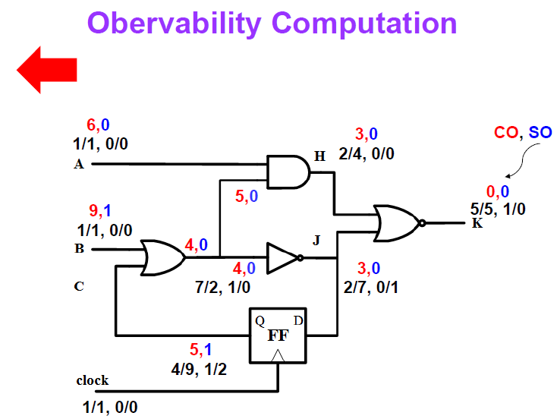

Slide 33
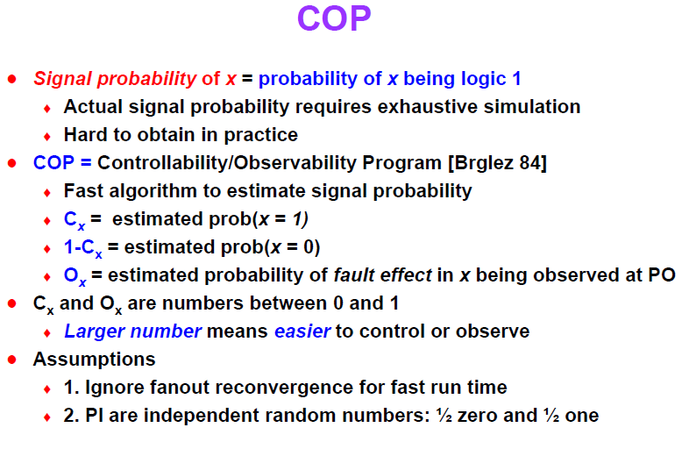

Slide 34
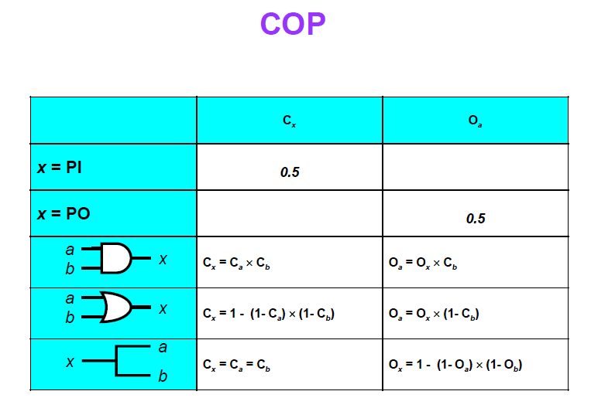

Slide 35
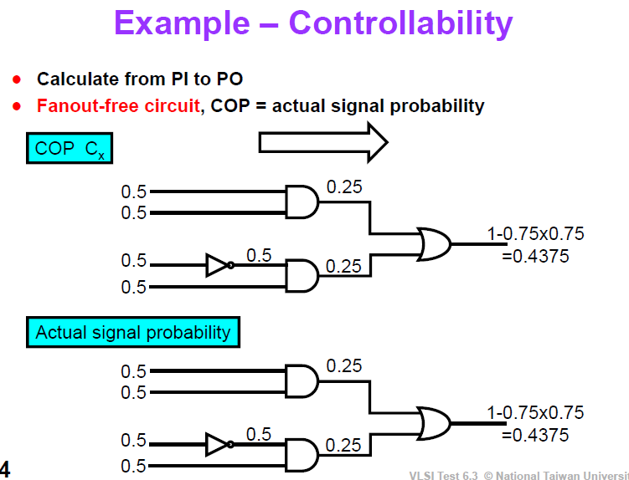

Slide 36
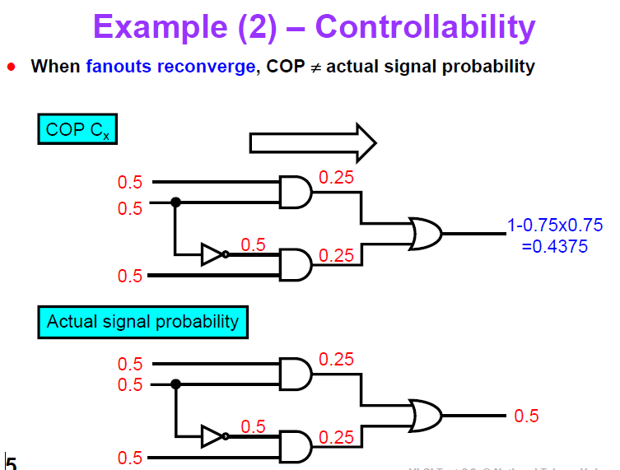

Slide 37
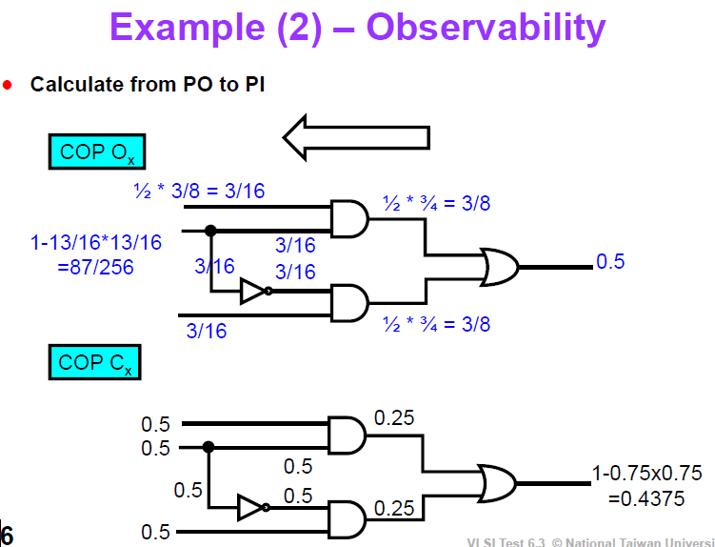

Slide 38
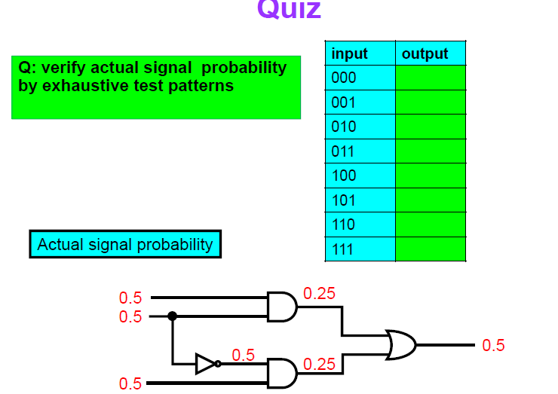

Slide 39
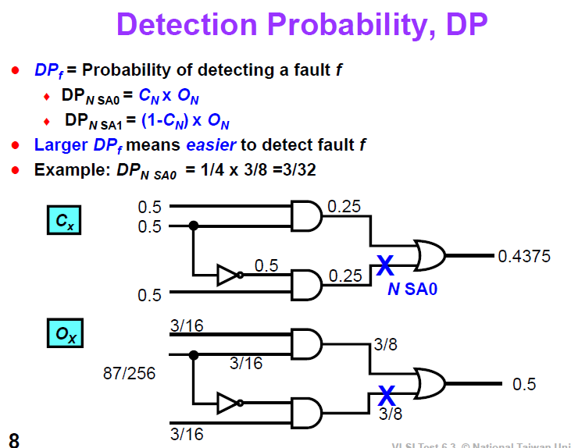

Slide 40
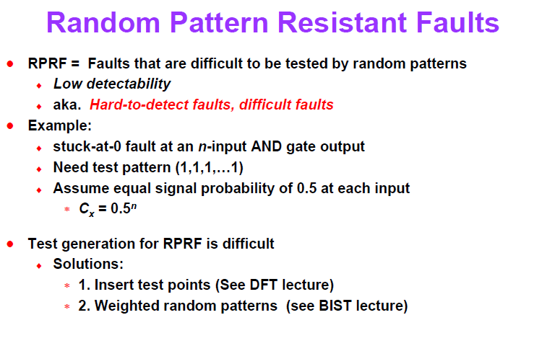

Slide 41
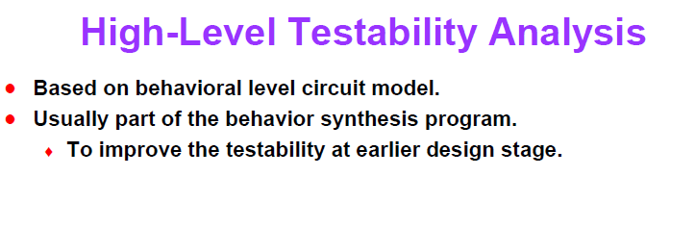

Slide 42
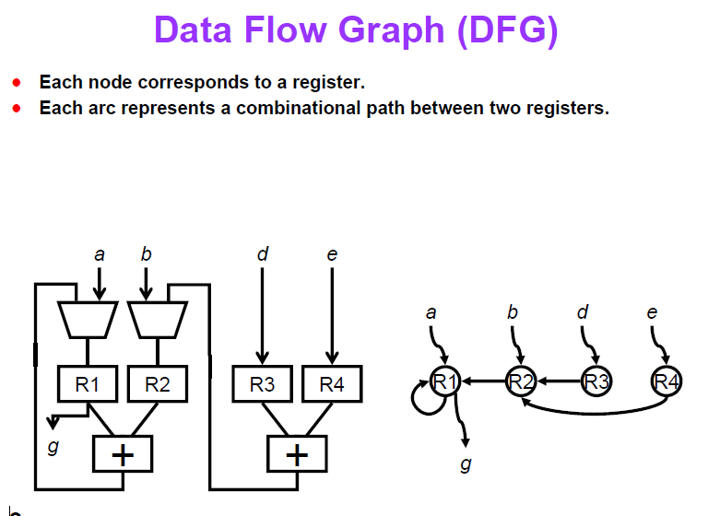

Slide 43
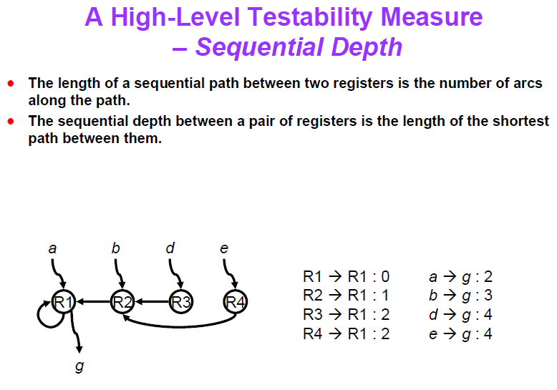

Slide 44
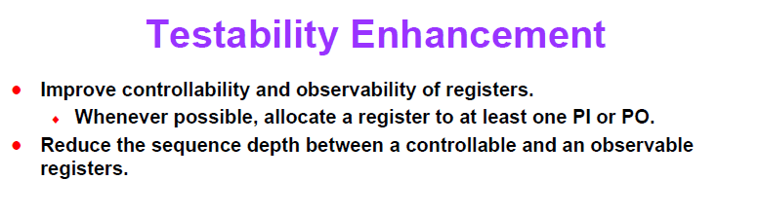

Slide 45
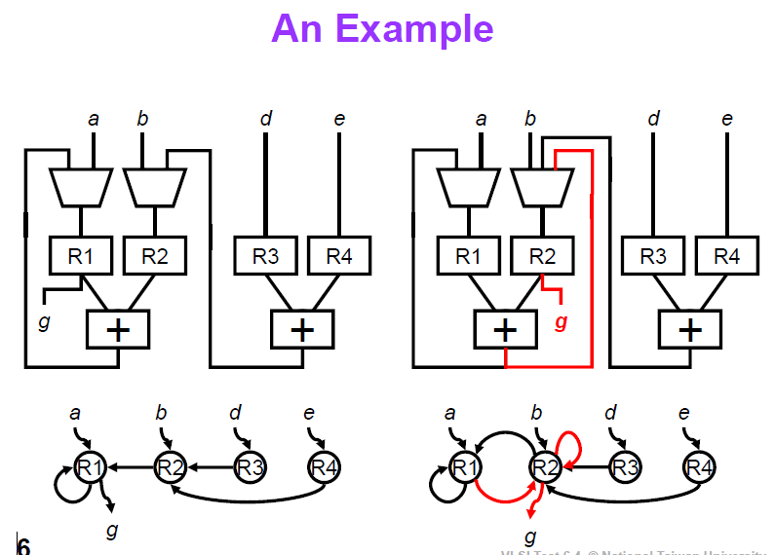

Slide 46
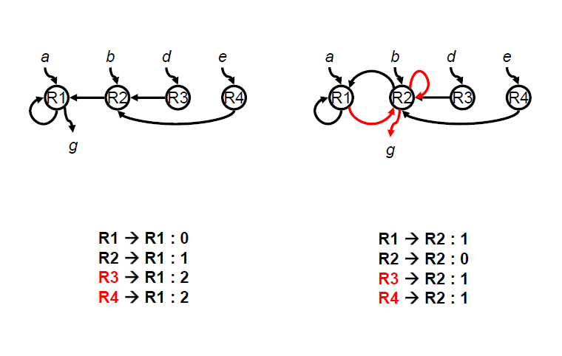

Slide 47
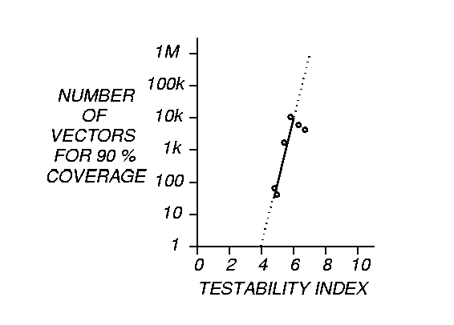

Slide 50
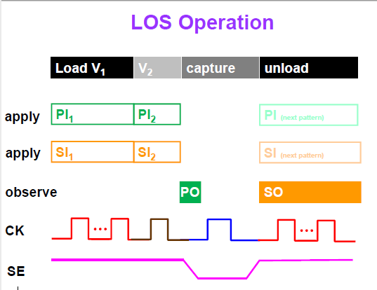

Slide 51
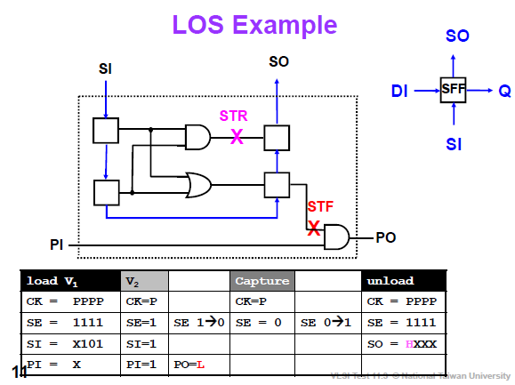

Slide 52
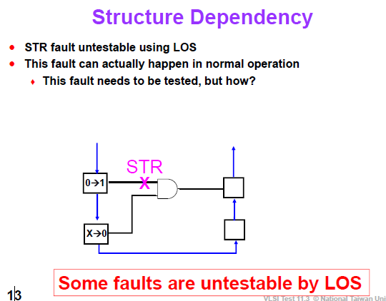

Slide 53
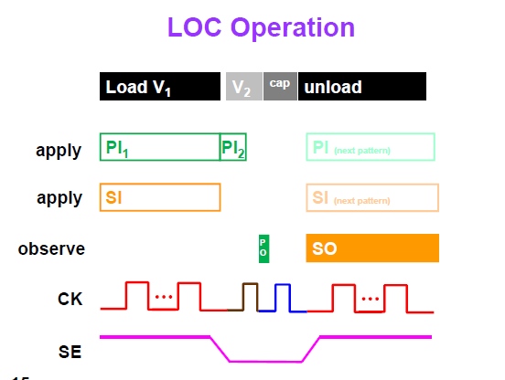
Launch on Capture

Slide 54
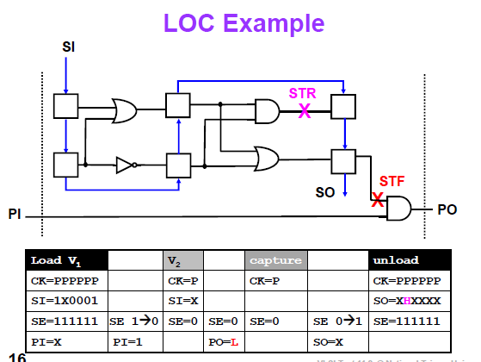

Slide 55
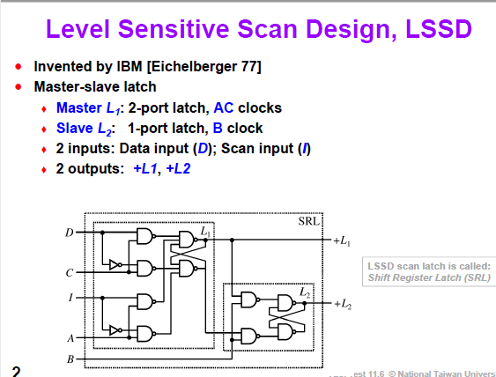

Slide 56
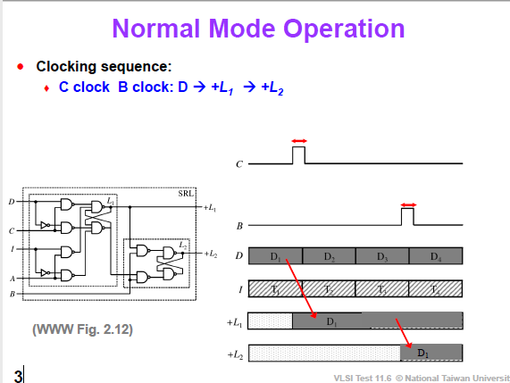

Slide 57
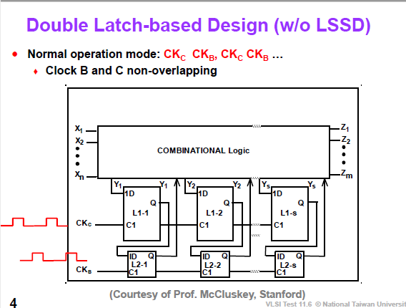

Slide 58
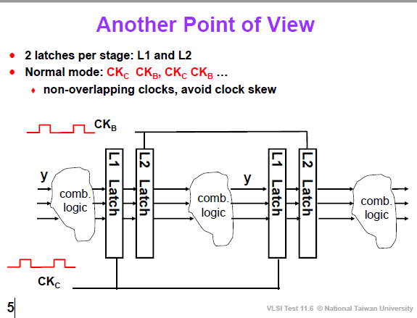

Slide 59
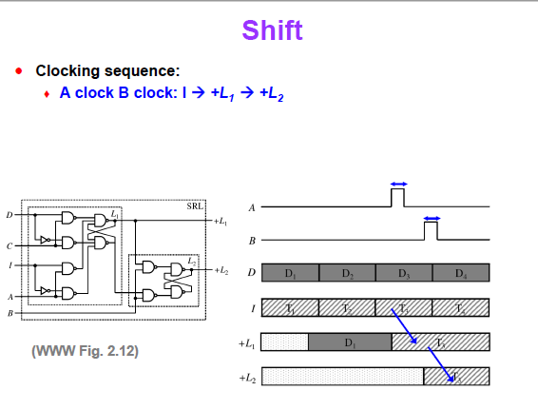

Slide 60


Slide 61


